Slide 1
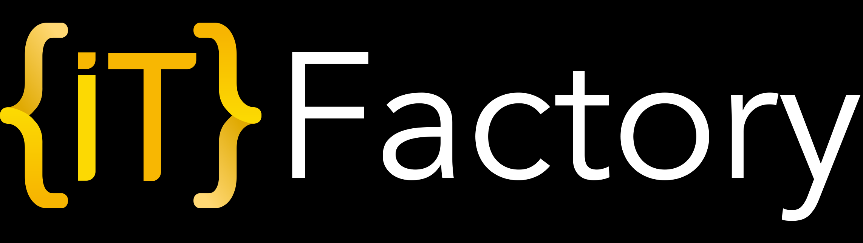
Intro to programming

Slide 2



Content
TESTING RELATED
CODE RELATED
PRACTICE

Slide 3
Topics
Intro to testing
The role of the automation tester
Some testing concepts around testing pyramid
STLC
How to start?

Slide 4
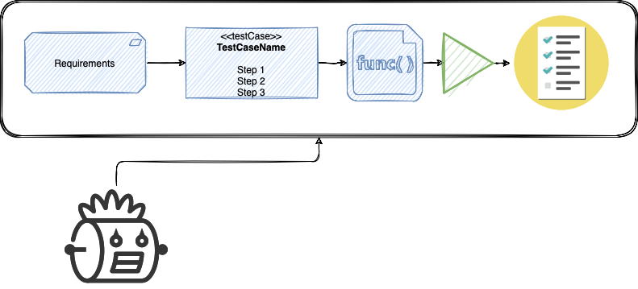
Testing related – our scope

Slide 5
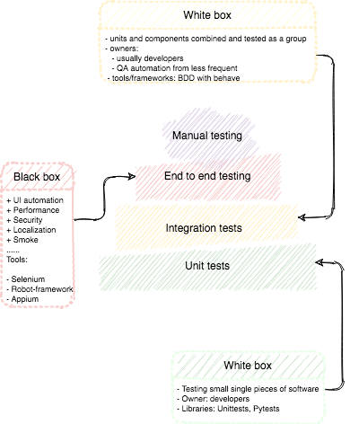
Testing related - pyramid

Slide 6
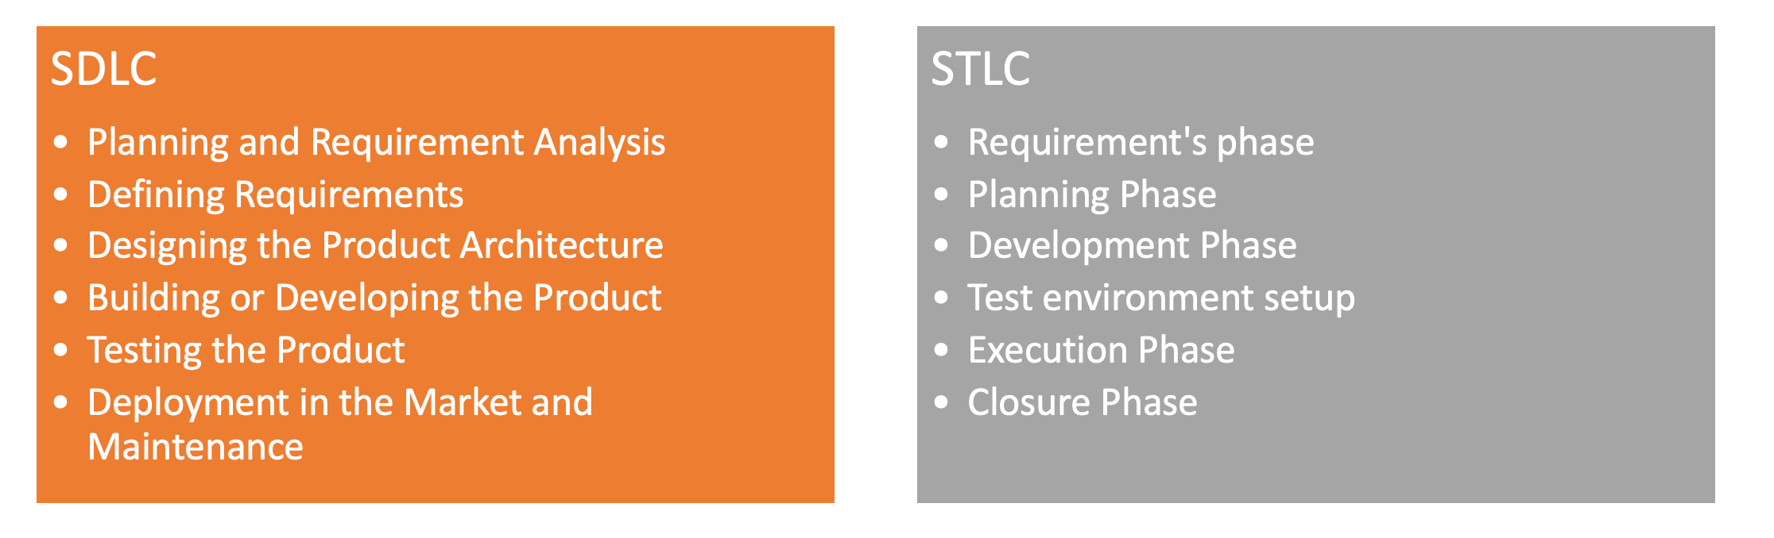
SDLC vs STLC

Slide 7
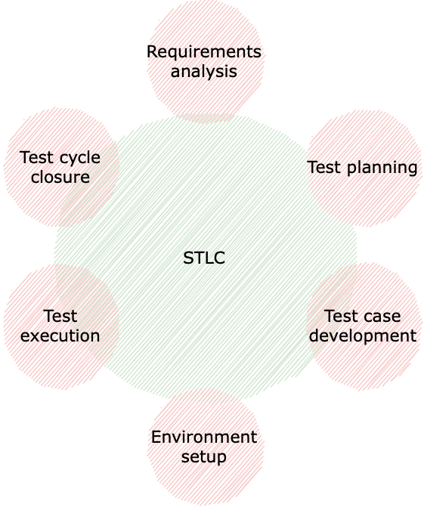
Testing related - STLC

Slide 8


How to start
Learn programming (Python)
Intro to programming
Design patterns
Full stack QA Automation”
Front end – Selenium
Backend – API testing

Slide 9
Code related
Why Python
Virtual environment
Environment setup
Variables & data types
Flow control
Functions

Slide 10
Why Python
Interpreted language (no need to compile the code)
Dynamically types (no need to declare the data type)
Platform independent
Easy syntax
Popular in various fields (Automated testing, Web development, Ethical hacking, DevOps, machine learning)

Slide 11
Environment setup
https://www.python.org/downloads/
windows/
Add Python to Path

Slide 12
Virtual environment
By default, all python packages are installed to a single directory on the system.
Virtual environments solve this by creating isolated python environments that can be customized per project.
Virtual environments are directories containing links to the system’s python install and providing sub-directories for installing additional python packages in that particular virtual environment.
The PATH environment variable is updated to point to the virtual environment when that virtual environment is activated.

Slide 13
Virtual environment
To create a virtual environment with venv you run the command: “python3 - m venv <VirtualEnvironmentName>.
Using Pycharm
Create a new project
Select Python interpretor
Automatically done
A short exercise: print(‘hello factory’). Deactivate venv run again
Notes:
Iq = 190
Snake_case
print(iq)

Slide 14
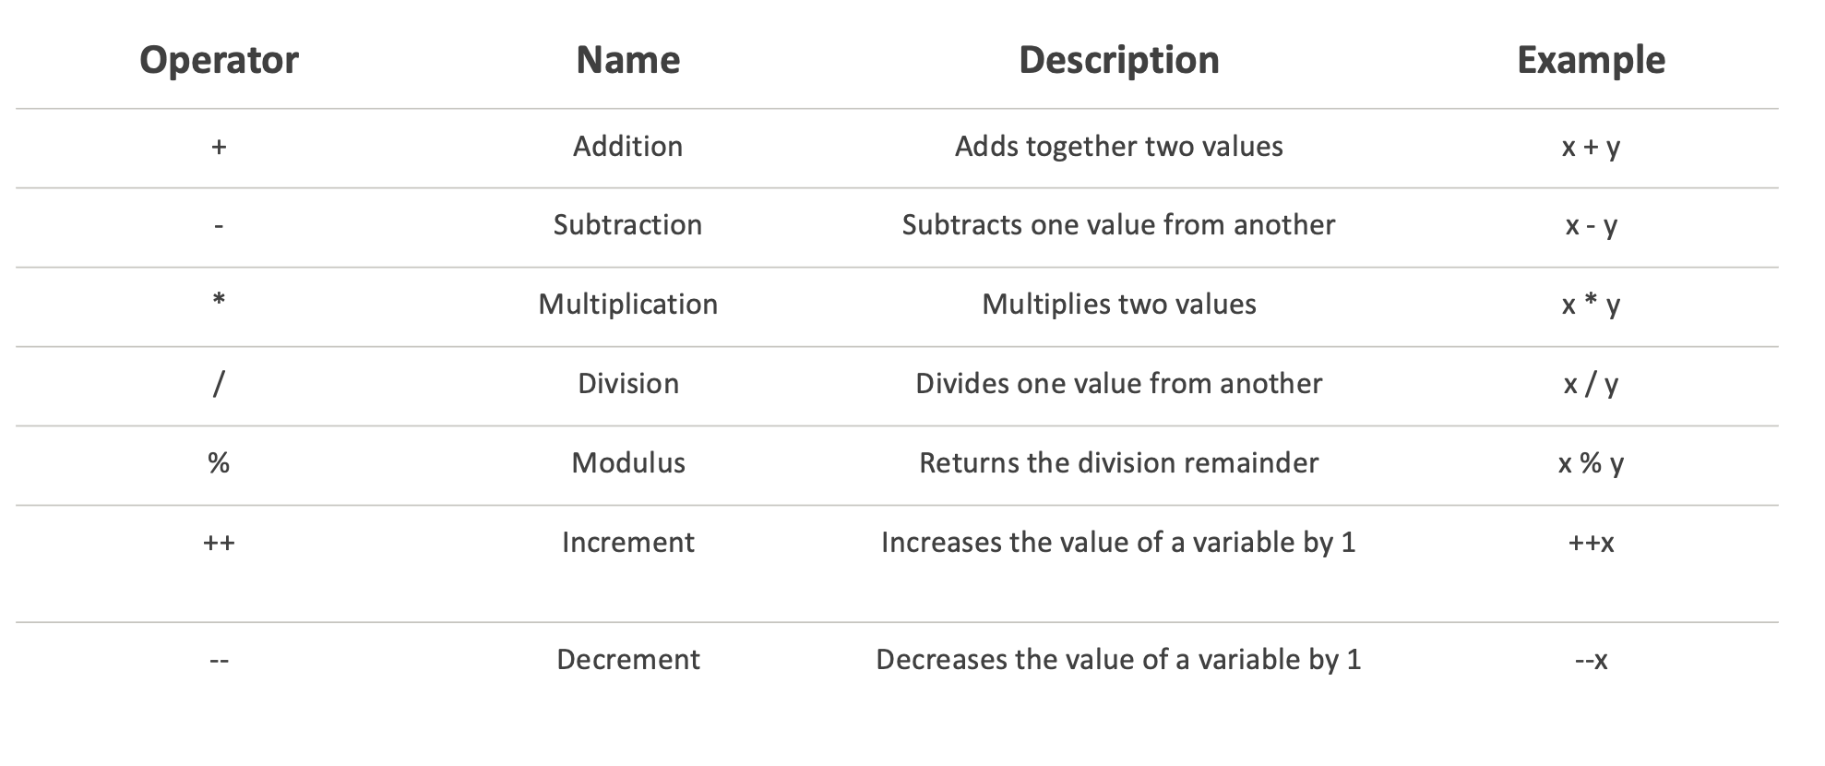
Basic operators (math)
Notes:
Iq = 190
Snake_case
print(iq)

Slide 15
Variables & data types
Storing information
Start with lowercase or underscore
Letters, numbers, underscores
Case sensitive
Don’t overwrite keywords

Slide 16
Variables & data types
user_iq
_user_iq
user_IQ does not work for printing user_iq
print(print) https://www.w3schools.com/python/python_ref_keywords.asp
Reuse variable. user_age = 190 a = user_age
Constants e.g. PI = 3.14 usage
Dunders __hi . Not a good practice
a, b, c = 1, 2, 3

Slide 17
Variables & data types
Define 3 variables a, b, c
1st one will have a number
2nd one will have a message
3rd one will be the 1st + 2nd
Fix the error

Slide 18
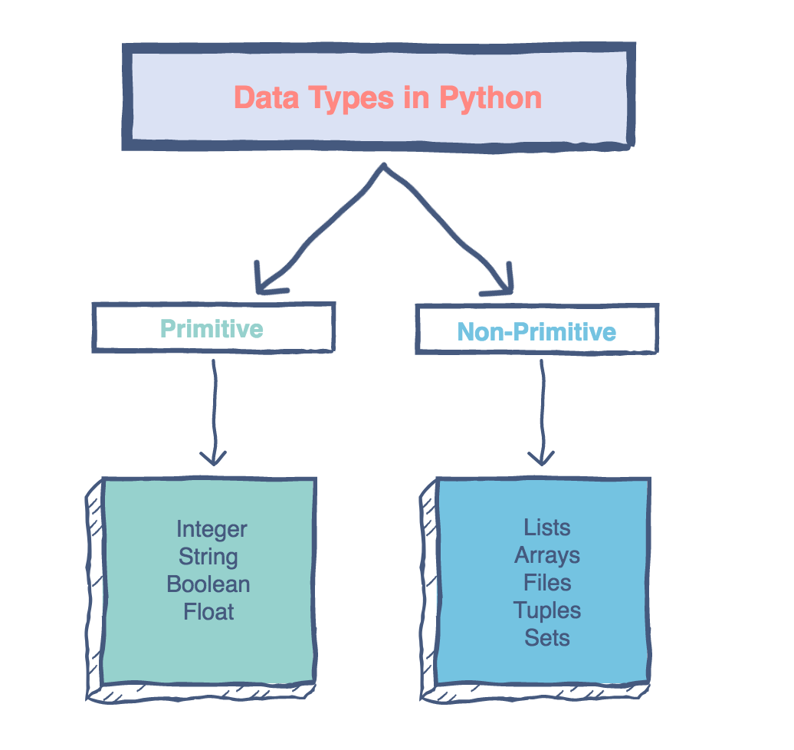
Variables & data types
Primitive data types which are pre-defined and supported by the programming language.
Non-primitive data types: Data types which are derived from the primitive data types and offer increased functionality. ​​

Slide 19
Variables & data types
How to check the data type? Type…
Integers – numeric data type with no limit in Python 3.
Float – decimal number
Boolean
Complex numbers: Complex numbers are specified as <real part>+<imaginary part>j e.g. 2+3j (x.real, x.imag)
Strings

Slide 20
Variables & data types
Int
Float
Boolean (true or false) ~ bool(1) is true bool(0) is false
Complet (optional) ~ real + imaginary e.g. 2 + 3j
String

Slide 21
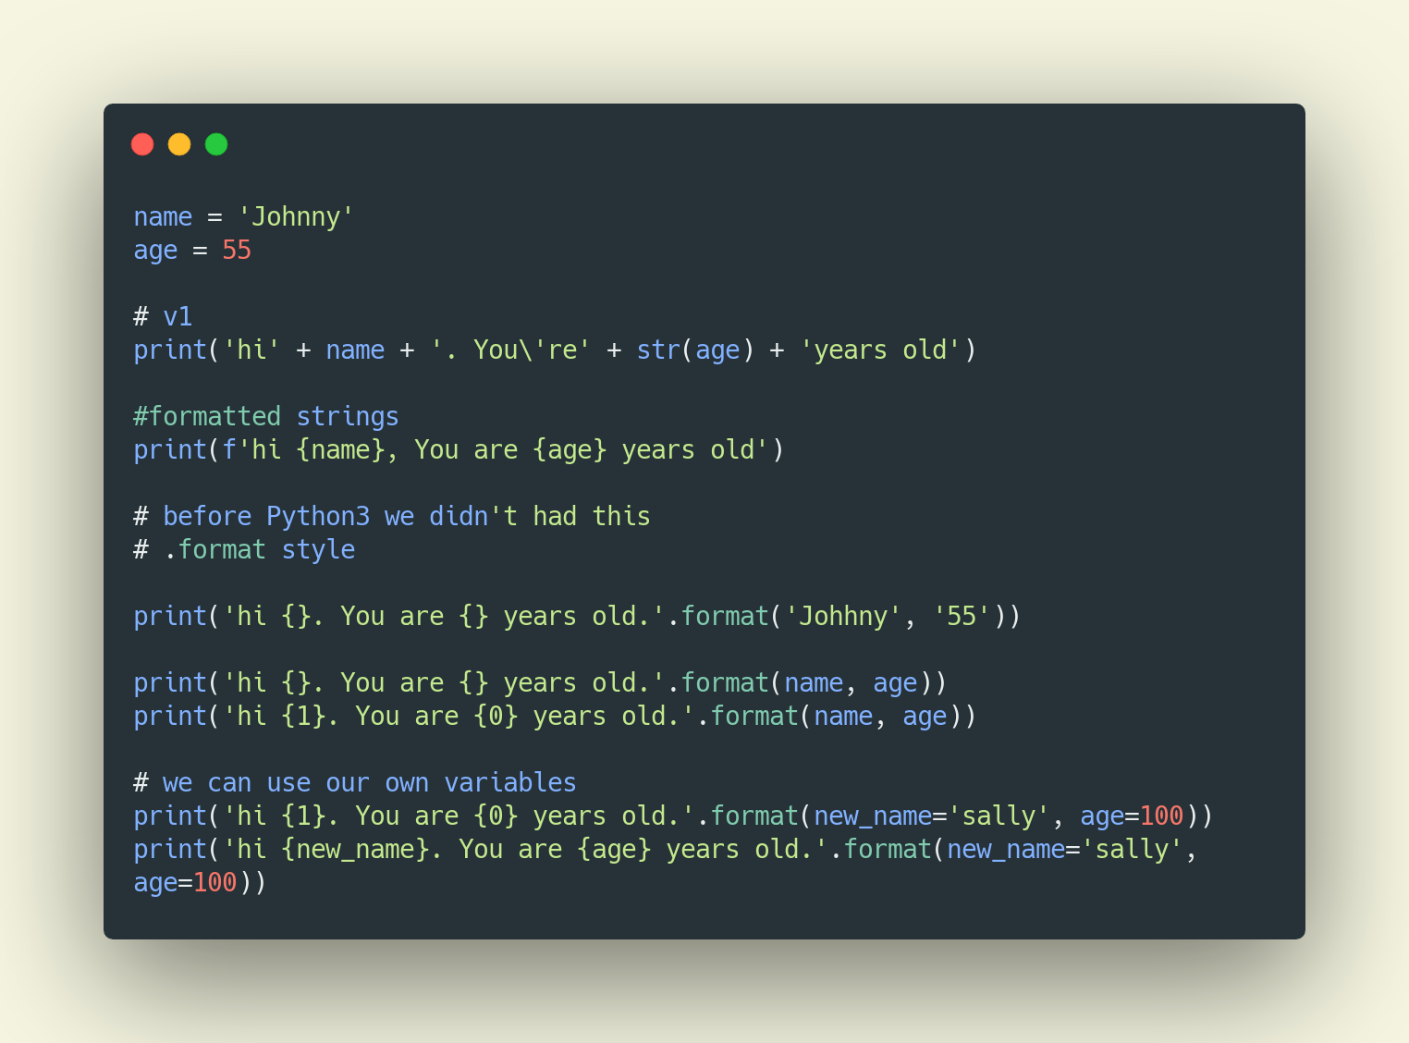
Variables & data types

Slide 22
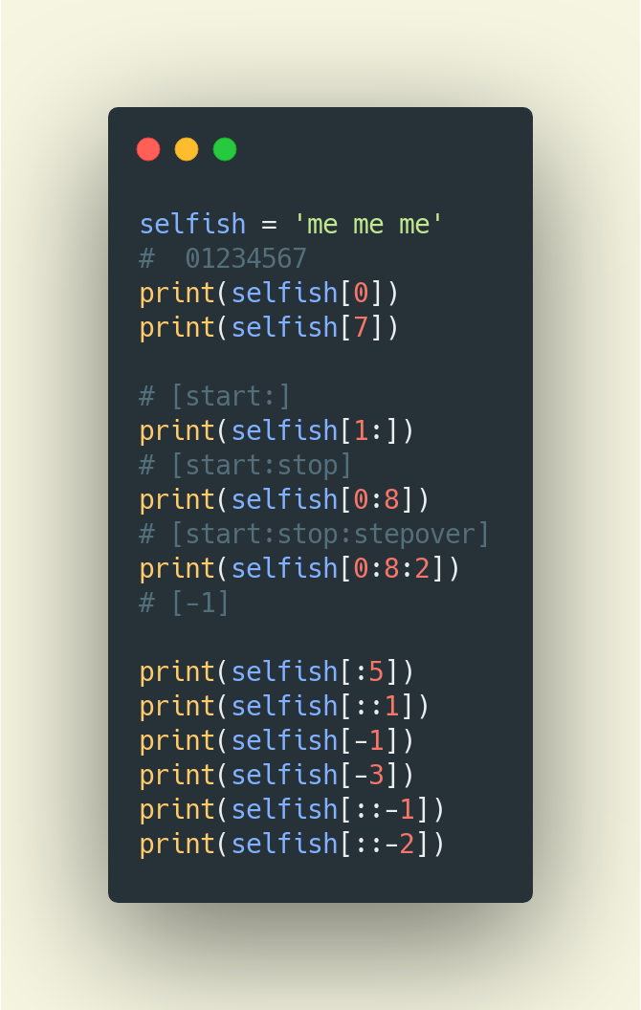
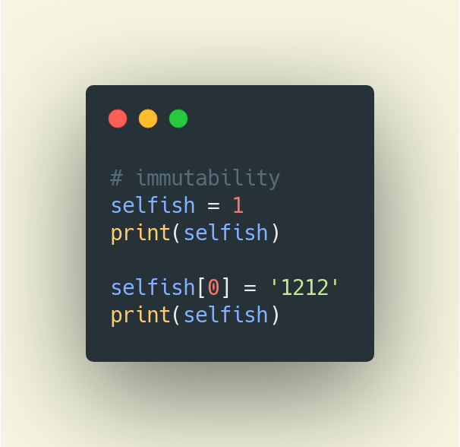
Variables & data types

Slide 23
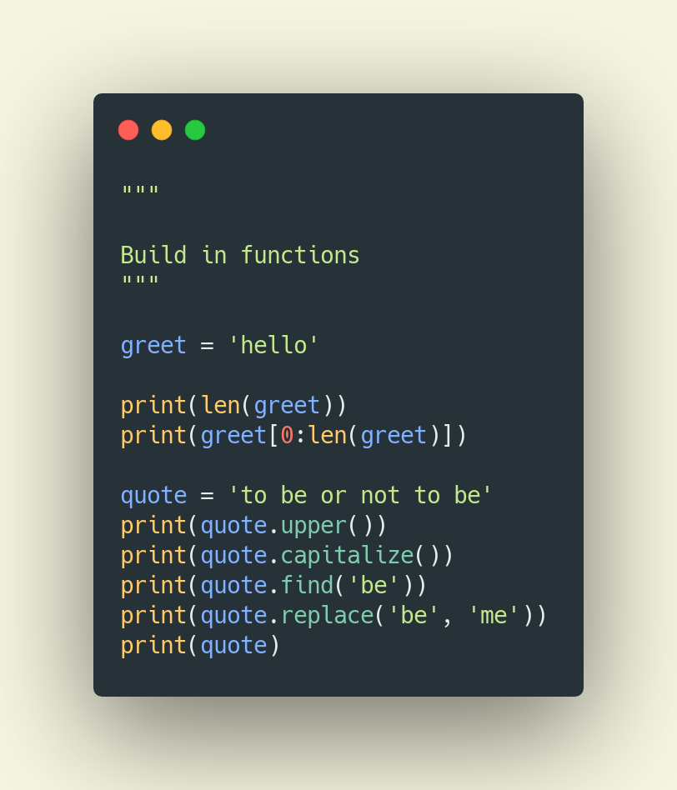
Variables & data types

Slide 24
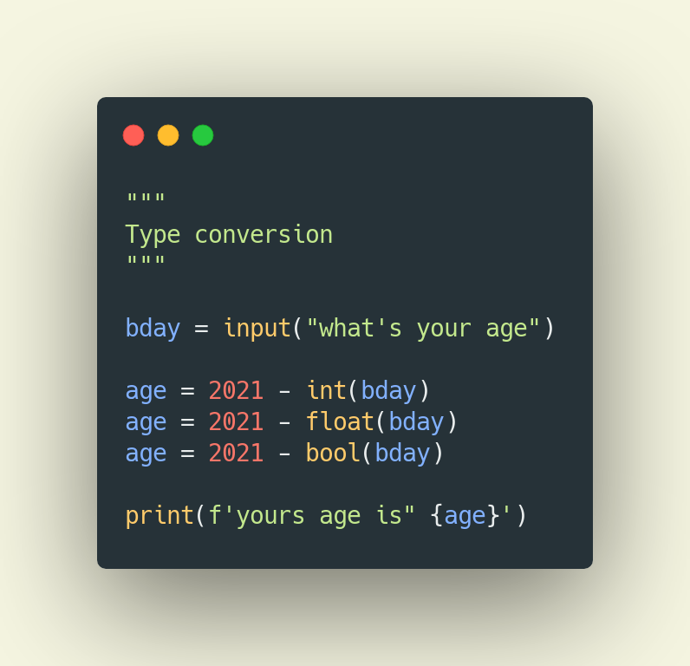
Variables & data types

Slide 25
Variables & data types (exercise)
Password checker script
Define a username getting input from the console
Define a password getting input from the console
Display the following message ‘The password for user Paul is ********* is 9 characters long)

Slide 26
Variables & data types
Build a program to calculate the followings using the input from the user for a, b, c or r
triangle area using input
rectangle area and perimeter
circle area
Which of the following are valid ways to specify the string literal foo'bar in Python:
'foo\'bar’
"""foo'bar""”
"foo'bar”
'foo''bar’
'foo'bar’

Slide 27




Variables & data types
LIST
DICT
TUPLES
SETS

Slide 28
Lists
Ordered sequence of items
[]
a = [1, 2.2, ‘snake’]
a[2], a[0:3], a[5:]

Slide 29
Lists
a[start:stop] # items start through stop-1
a[start:] # items start through the rest of the array
a[:stop] # items from the beginning through stop-1
a[:] # a copy of the whole array

Slide 30
Lists - methods
Append
Insert
Extend
Pop
Remove
Clear
Index
Count
Sort
Sorted
Copy
Reverse
Len

Slide 31
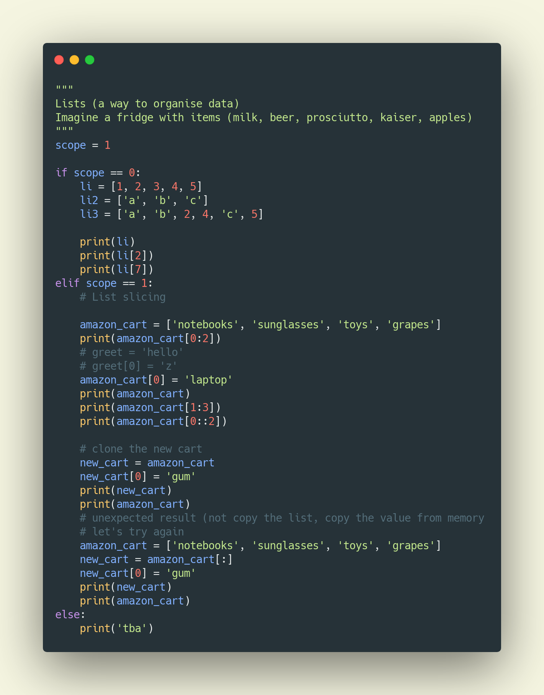
Lists

Slide 32
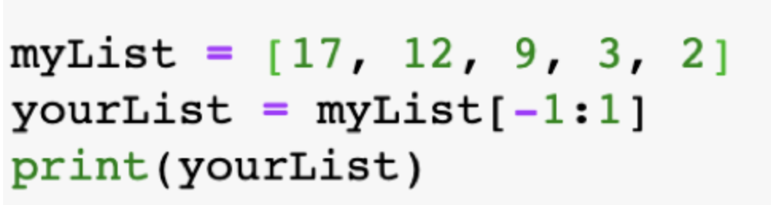
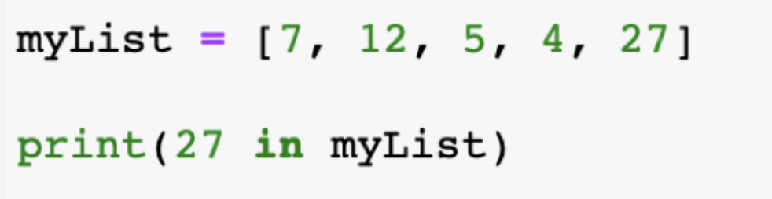
Lists - quiz
The output of the following code will be an empty list:
True
False
Select the correct output of the following code:
False
True
27
None

Slide 33
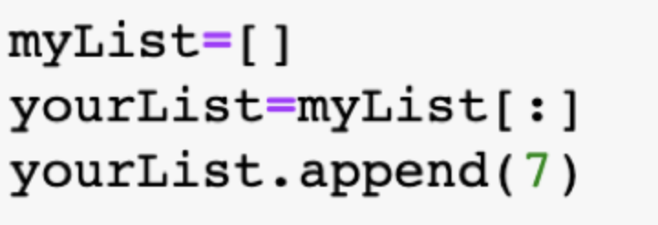
Lists - quiz
If you run the below code the length of yourList will be same as the length of myList :
True
False
If your List named myList contains 400 items, when will you get the IndexError while accessing the list items?
myList[-1]
myList[400]
myList[0]
myList[-2]

Slide 34



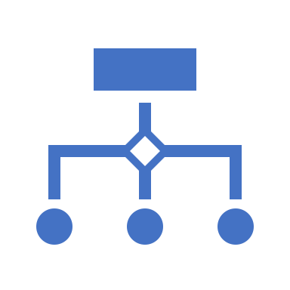
Tuples
Tuple is an ordered sequence of items same as a list. The only difference is that tuples are immutable. Tuples once created cannot be modified.
Tuples are used to write-protect data and are usually faster than lists as they cannot change dynamically.
It is defined within parentheses () where items are separated by commas.
Example: t = (5,'program', 1+3j)

Slide 35
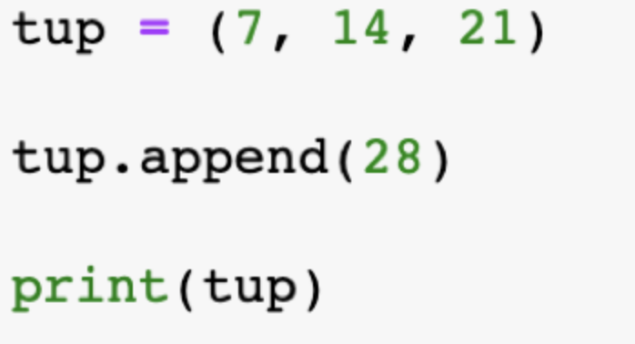
Tuples - quiz
1. Which of the following is not a tuple type?
Tup=(4)
Tup=(4,)
Tup=()
Tup=1,
4. What will be the output of the following code?
(7, 14, 21, 28)
(28)
AttributeError
2. A tuple is an immutable sequence type in Python.
True
False
3. Which of the following are the incorrect ways to create tuple?
a=(2,3,4)
a=2,3,4,5
a={2,3,4,4}
a=[2,3,4,4]

Slide 36
Sets
Set is an unordered collection of unique items
Set is defined by values separated by comma inside braces { }
Items in a set are not ordered.
a = {5,2,3,1,4}

Slide 37
Sets
Which is the output of the following statement:
a = {1, 2, 3} a.pop() a.pop() a.pop() a.pop() print(a)
1
{1, 2}
{}
Traceback (most recent call last):

Slide 38


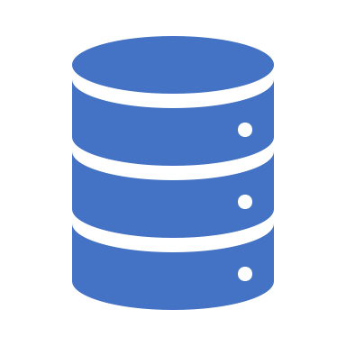


Dictionaries
Dictionary is an unordered collection of key-value pairs.
It is generally used when we have a huge amount of data.
Dictionaries are optimized for retrieving data. We must know the key to retrieve the value.
In Python, dictionaries are defined within braces {} with each item being a pair in the form key:value. Key and value can be of any type.
d = {1:'value','key':2}

Slide 39
Dictionaries
Which of the following is incorrect for a dictionary in Python?
Each key must be unique
The key should be an immutable object
The len() function returns the number of key-value elements in the dict
The len() function returns the sum of the key-value elements in the dict
In Python Dictionary, keys are case-sensitive:
True
False
What does the method items() return in Python Dictionary?
The lists
The tuples
The keys in a list
The values in a list

Slide 40




More about testing
Why we need this?
Bug – first thing to keep in mind
Types of testing
SDLC & STLC

Slide 41
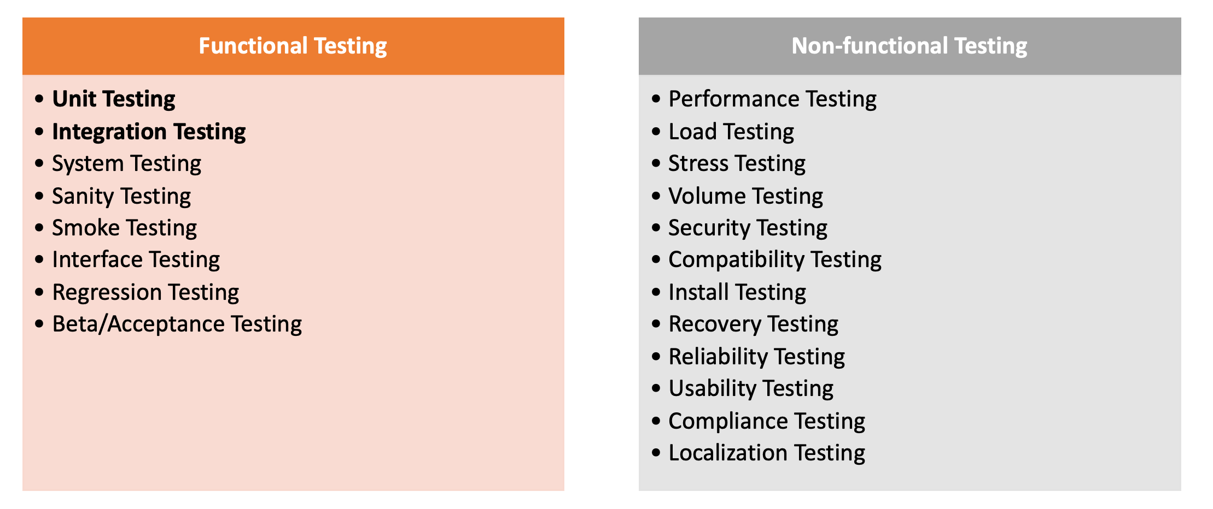
More around testing

Slide 42
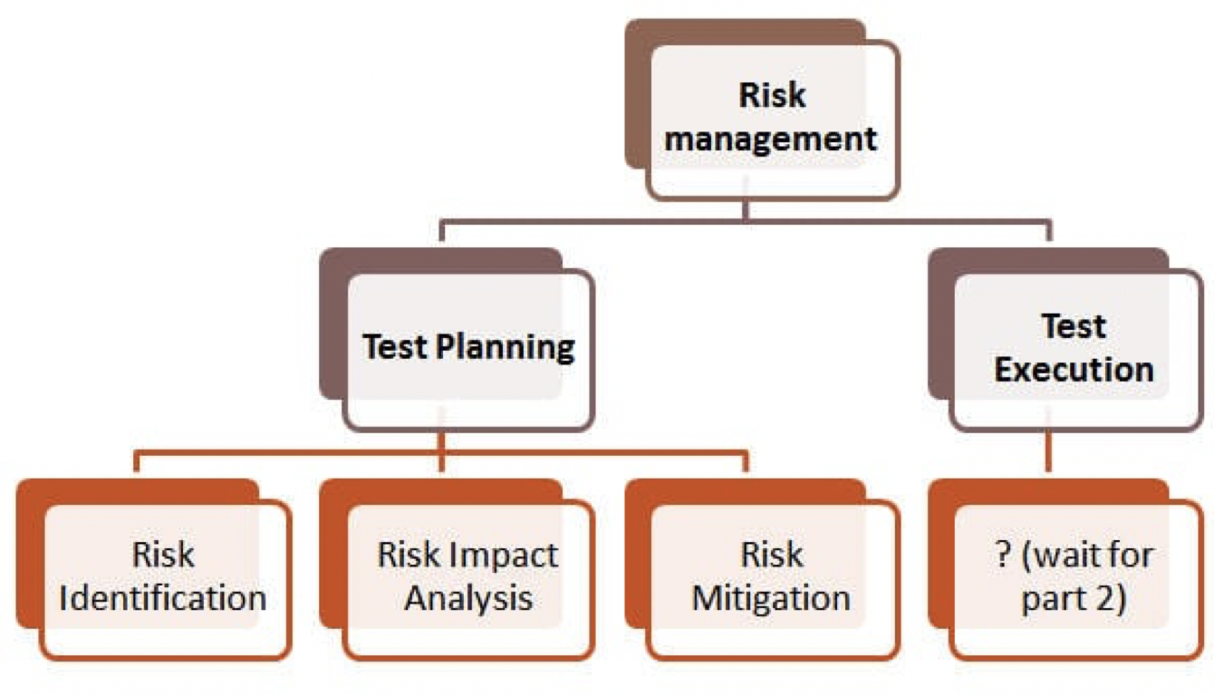
More around testing

Slide 43
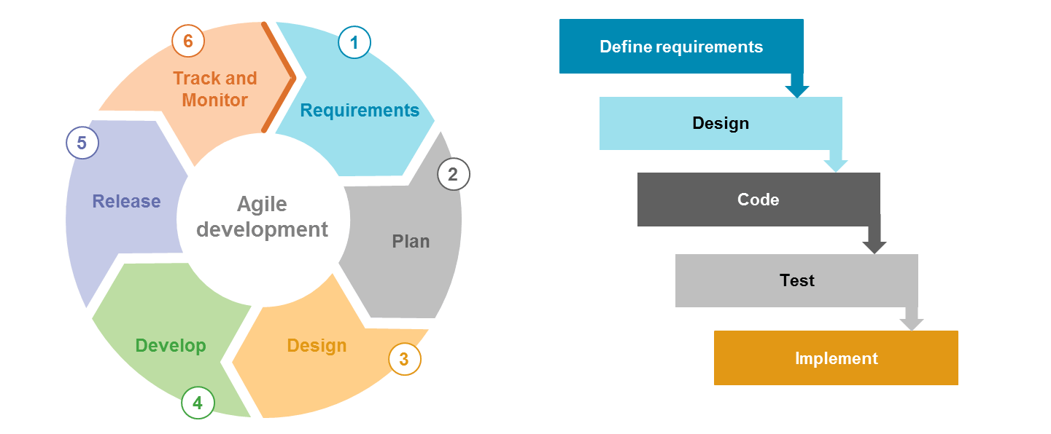
More around testing

Slide 44
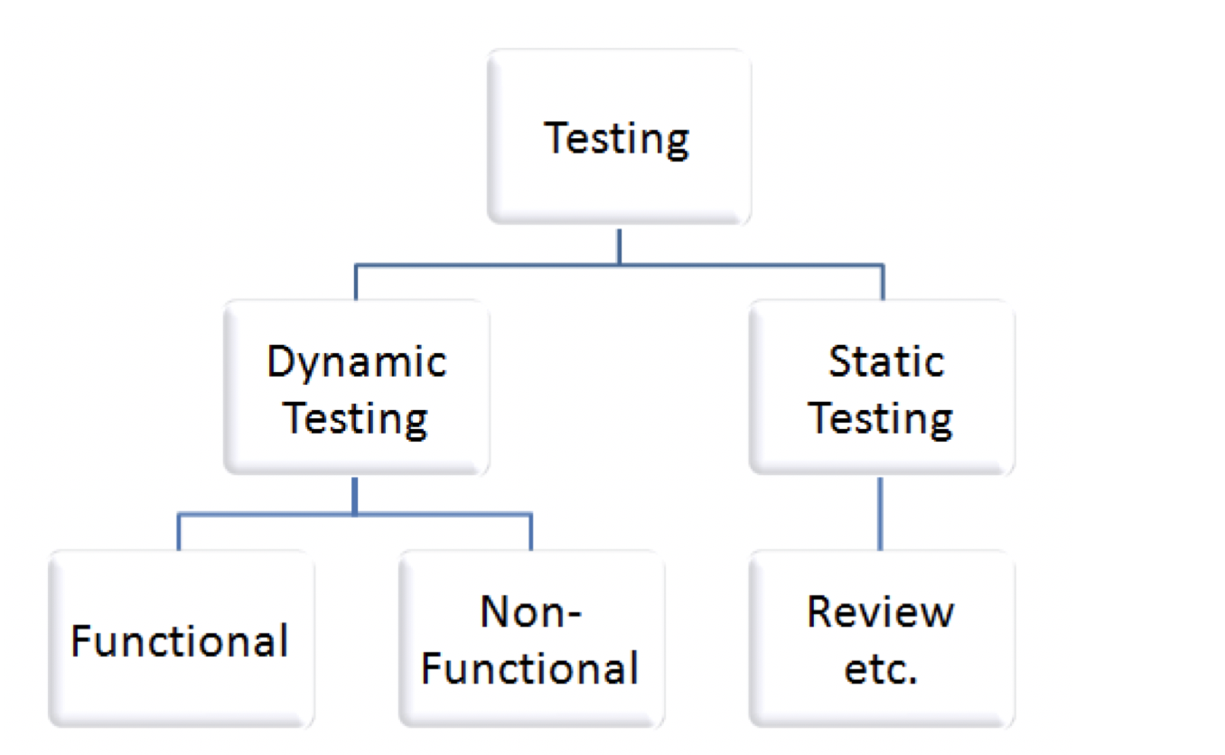
More around testing

Slide 45
Static code analysis & debugging
Use linters
Pdb or Pycharm debugger
Pdb (optional)
Num1
Num2
T
Help
Continue
A
w

Slide 46




Flow control
IF ELSE
FOR LOOP
WHILE LOOP
BREAK AND CONTINUE
PASS

Slide 47
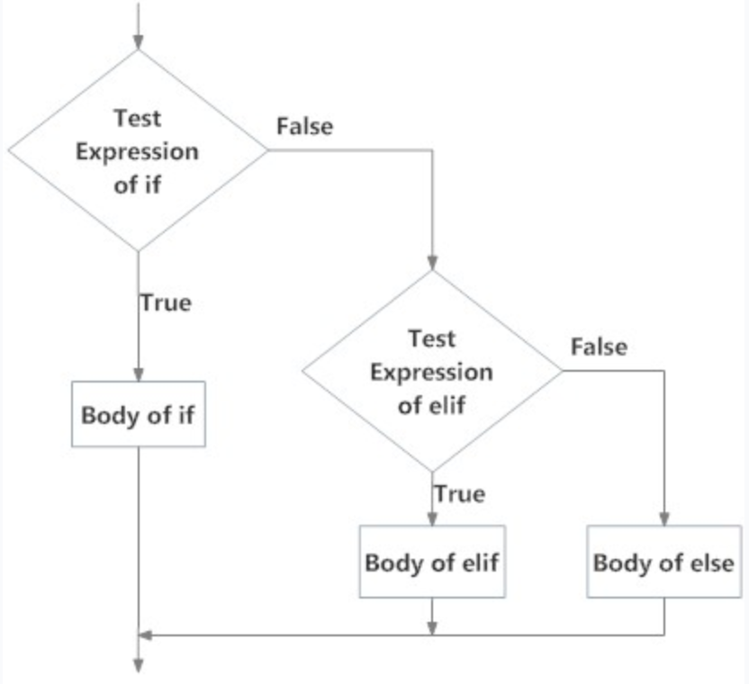
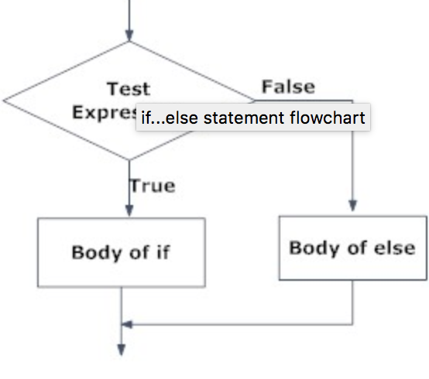
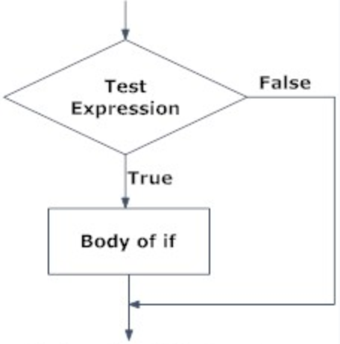
Flow control – if else

Slide 48
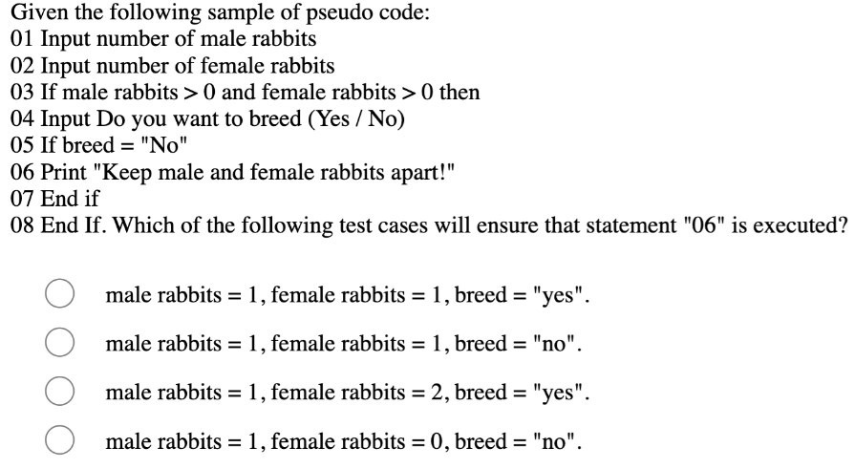
Flow control – if else

Slide 49
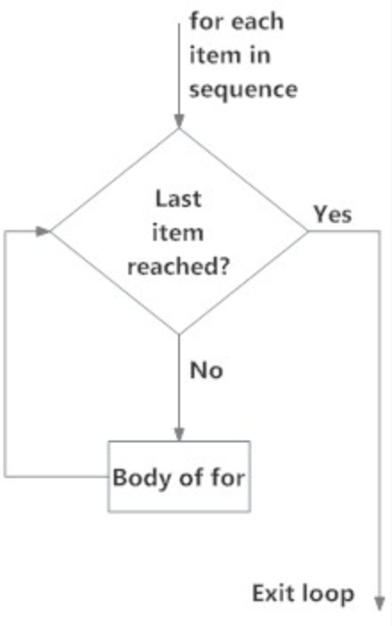
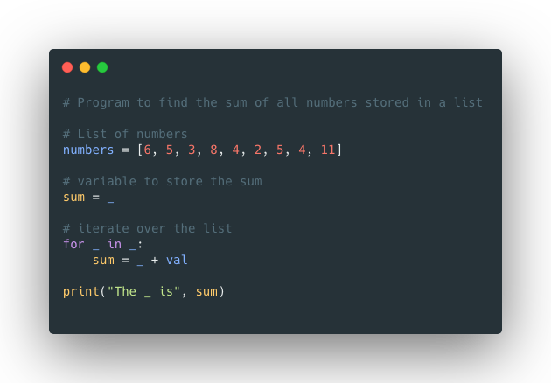
Flow control - for loop
Exercises:
Replace _ with the right code
Update the following snippet using range

Slide 50
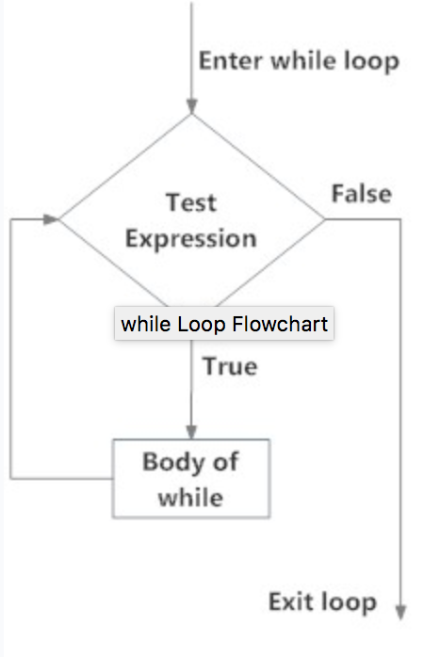
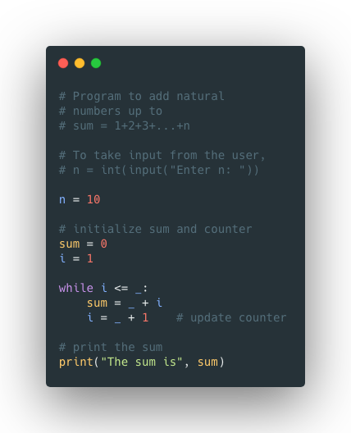
Flow control – while loop
Exercises
Replace the _ with the right piece of code
Refactor the For exercise using a loop
Design a do while e.g.

Slide 51
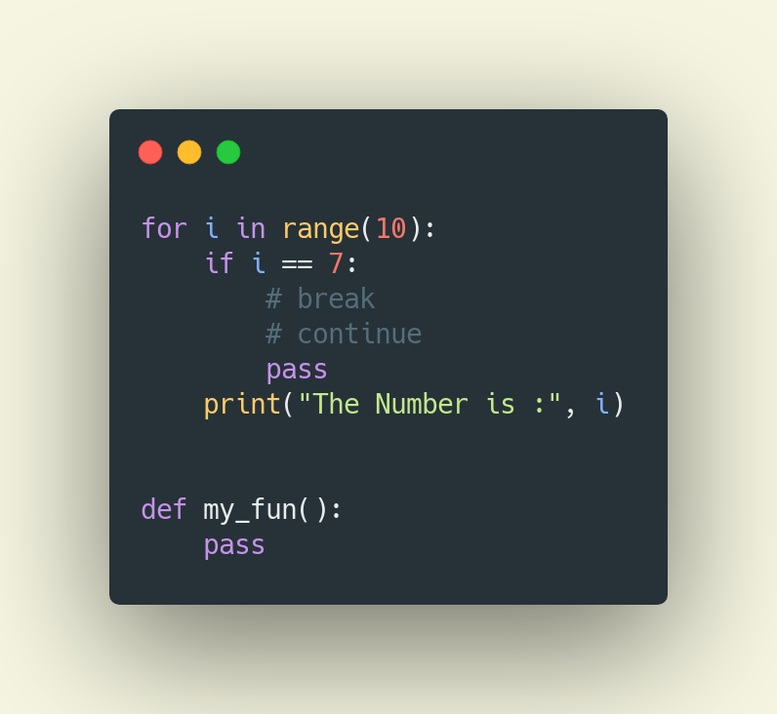
Flow control – break, continue & pass

Slide 52
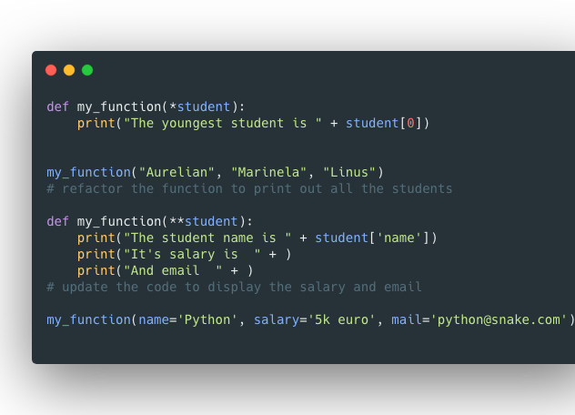
Functions
What is it? A block of code which runs only when it is called
Defined using def keyword
Usage of parameter and argument
Arbitrary arguments *args
Arbitrary Keyword Arguments **kwargs
Default parameter: def fun(x=‘Pfizer’): print(x)
Return and pass
Some other exercise: merge the area computing code into stand alone functions
Let’s design some test cases

Slide 53
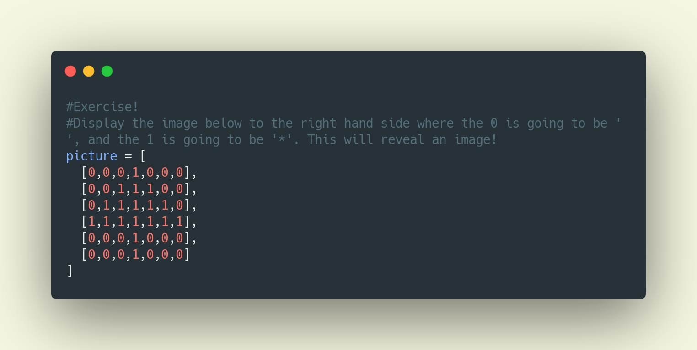
Exercises
Refactor the triangle and rectangle problems using functions
Calculate the sum of all the elements from a list using an iterable

Slide 54
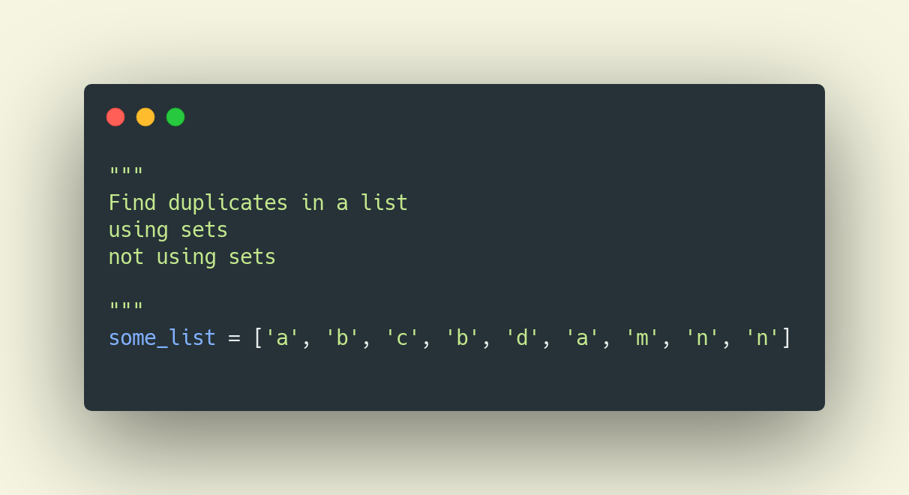
Exercises

Slide 55
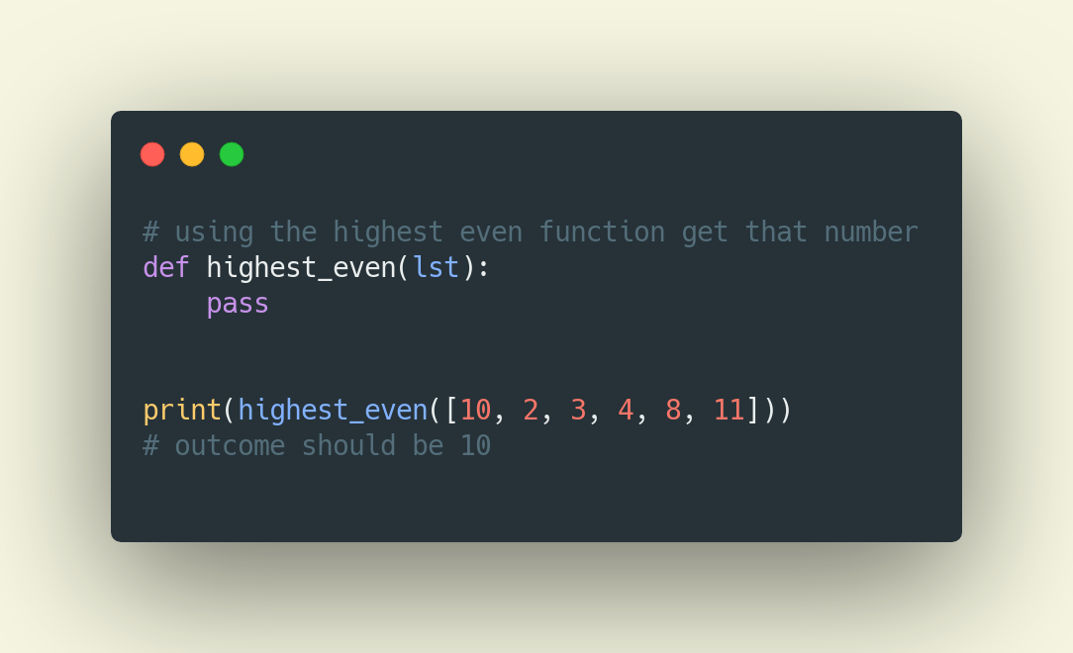
Exercises

